Slide 1

Human activity recognition system
International Conference on Recent Advances in Engineering , Technology and Science (ICRAETS-2021), 02 May, Hyderabad
Priyanshu jain, Information Technology, Medi-Caps University Indore, India
SAMYAK JAIN, Information Technology, Medi-Caps University, Indore, India
Sarthak ranka, Information Technology, Medi-Caps University. Indore, India
Guided by: MS. SHRUTI DHANOTIYA,ASSISTANT PROFESSOR, Information Technology, Medi-Caps University. Indore, India

Slide 2
OBJECTIVE OF PROJECT
Our objective of project is to recognize the human activity using Human Activity Recognition System using CNN and LSTM Model.
Human activity recognition (HAR) aims to classify a person's actions from a series of measurements captured by sensors. Action recognition concerns the extraction of activity based knowledge, image data relationship or other patterns implicitly or explicitly stored in the images.

Slide 3
Introduction of Subject
Human activity recognition using smartphone sensors like accelerometer is one of the hectic topics of research.
HAR is one of the time series classification problem. In this project various machine learning and deep learning models have been worked out to get the best final result. In the same sequence, we have use LSTM (long short term memory) model of the Recurrent Neural Network (RNN) to recognize various activities of humans like WALKING,WALKING_UPSTAIRS,WALKING_DOWNSTAIRS,SITTING,STANDING,LAYING.
LSTM model is a type of recurrent neural network capable of learning order dependence in sequence prediction problems. This model is used as this helps in remembering values over arbitrary intervals.

Slide 4
Introduction of Subject Contd…
Python 2.7 is used during development and following libraries are required to run the code provided in the notebook: Tensorflow, Numpy, Matplotlib, Pandas.
Human activity recognition concerned with identifying the specific movement or action of a person based on sensor data.
The problem is to predict the activity given a snapshot of sensor data, typically data from one or a small number of sensor types. Generally, this problem is framed as a univariate or multivariate time series classification task.
It is a challenging problem as there are no obvious or direct ways to relate the recorded sensor data to specific human activities and each subject may perform an activity with significant variation, resulting in variations in the recorded sensor data.
The intent is to record sensor data and corresponding activities for specific subjects, fit a model from this data, and generalize the model to classify the activity of new unseen subjects from their sensor data.

Slide 5
Abstract of the Paper:-
Human activity recognition (HAR) has become a popular topic of research because of its wide application. Computers are getting better at solving some very complex problems (like understanding an image) due to the advances in computer vision. Models are being made wherein, if an image is given to the model, it can predict what the image is about, or it can detect whether a particular object is present in the image or not. Here, a deep network architecture using residual bidirectional long short-term memory (LSTM) cells is proposed .
Here we uses deep learning for Video Recognition - given a set of labelled videos, train a model so that it can give a label/prediction for a new video .Generally, the proposed network shows improvements on both the temporal (using bidirectional cells) and the spatial (residual connections stacked deeply) dimensions, aiming to enhance the recognition rate. Finally, the confusion matrix of the public domain UCI data set was analyzed.

Slide 6
Abstract Contd….
The topic of Human activity recognition (HAR) is a prominent research area topic in the field of computer vision and image processing area. It has empowered application in multiple sectors, surveillance, digital entertainment and medical healthcare.
It is interesting to observe and intriguing to predict such kind of movements. Several sensor-based approaches have also been introduced to study and predict human activities such accelerometer, gyroscope, etc., it has its own advantages and limitations.
In this project, an intelligent human activity recognition system is developed. Convolutional neural network (CNN) with spatiotemporal three dimensional (3D) kernels are trained using Kinetics data set which has different classes that depicts activities of humans in their everyday life and work and consist of videos for each class.
Finally the results show promising activity recognition of different human actions. Different Machine learning techniques like are reviewed for HAR and later the survey for deep neural network techniques like artificial neural networks, convolutional neural networks and recurrent neural networks is also presented.

Slide 7
Research Procedure and Data Presentation
Human activity recognition (HAR) is of value in both theoretical research and actual practice. It can be used widely, including in health monitoring [1], smart homes [2], and human–computer interactions [3]; for example, LSTM cells are a good choice for solving HAR problems.
The aim of this project is to create a model that can identify the basic human actions like walking, standing, sitting, walking_upstairs, walking_downstairs, laying .The model will be given a set of videos where in each video, a person will be performing an action. The label of a video will be the action that is being performed in that particular video.
The model will have to learn this relationship, and then it should be able to predict the label of an input (video) that it has never seen. Technically, the model would have to learn to differentiate between various human actions, given some examples of these actions.

Slide 8
Research Procedure and Data Presentation Contd…
Unlike traditional algorithms, LSTM can catch relationships in data on the temporal dimension without having to mix the time steps together as a 1D CNN would do.
LSTM architecture can offer great performance and many potential applications. A public domain benchmark of HAR has been introduced, and different methods of recognition have been analyzed [4]. The results showed that the K-Nearest Neighbor (KNN) algorithm outperforms other algorithms in most recognition tasks. Unlike the manual filtering features in previous algorithms, a systematic feature learning method that combines feature extraction with CNN training has also been proposed. Although researchers have made great strides in HAR, room for improvement remains. Inspired by previous neural networks’ architectures, we describe a novel Deep Residual Bidirectional Long Short-term Memory LSTM (Deep-Res-Bidir-LSTM) network. The deep LSTM has improved learning ability and, despite the time required to reach maximum accuracy, shows good accuracy early in training; it is especially suitable for complex, large-scale HAR problems where sensor fusion would be required. Residual connections and bidirectional communication through time are available to ensure the integrity of information flowing deeply through the neural network. In recent years, deep learning has shown applicability to many fields, such as image processing [5], speech recognition [6], and natural language processing [7].

Slide 9
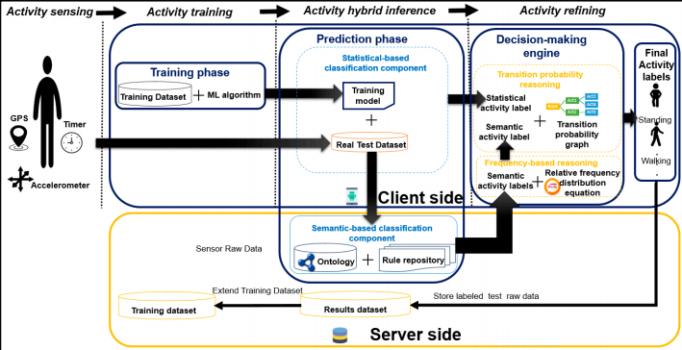
Archietecture diagram

Slide 10
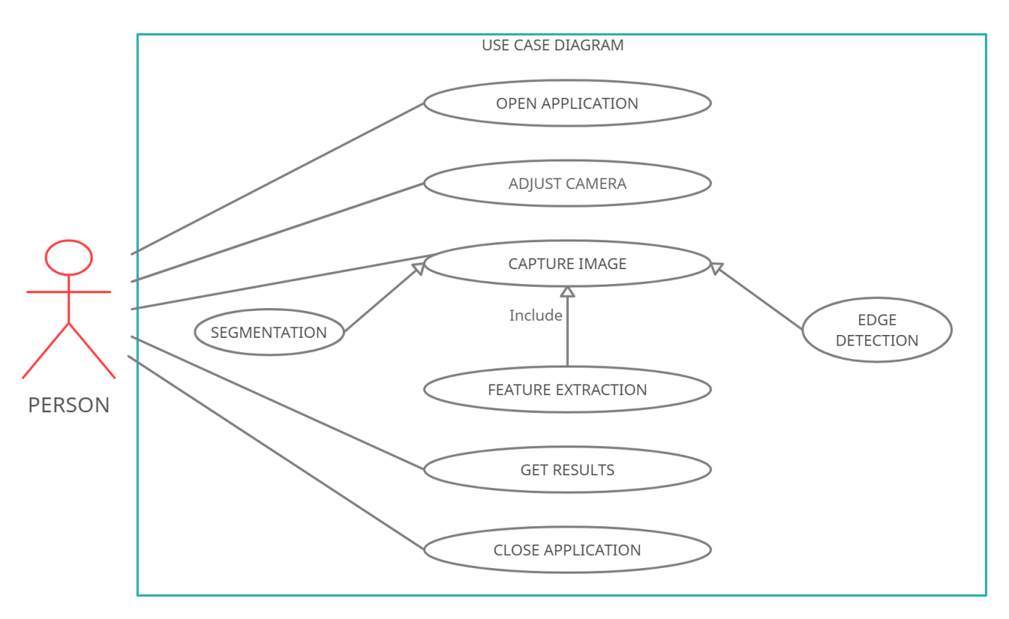
Use case diagram

Slide 11
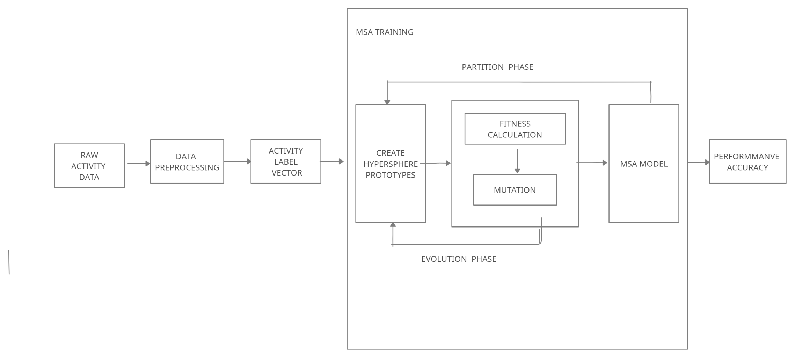
Flow diagram

Slide 12
Methodology
Data pre-processing
1. Reading in the video frame-by-frame.
2. The videos were captured at a frame rate of 25fps. This means that for each second of the video, there will be 25 frames. We know that within a second, a human body does not perform very significant movement. This implies that most of the frames (per second) in our video will be redundant. Therefore, only a subset of all the frames in a video needs to be extracted. This will also reduce the size of the input data which will in turn help the model train faster and can also prevent over-fitting. Different strategies would be used for frame extraction like:
Extracting a fixed number of frames from the total frames in the video – say only the first 200 frames (i.e., first 8 seconds of the video).
Extracting a fixed number of frames each second from the video – say we need only 5 frames per second from a video whose duration is of 10 seconds. This would return a total of 50 frames from the video. This approach is better in the sense that we are extracting the frames sparsely and uniformly from the entire video.
3.Each frame needs to have the same spatial dimensions (height and width). Hence each frame in a video will have to be resized to the required size.
4.In order to simplify the computations, the frames are converted to grayscale.
5.Normalization – The pixel values ranges from 0 to 255. These values would have to be normalized in order to help our model converge faster and get a better performance.

Slide 13
Process PIPELINE OF HAR
The process pipeline of HAR can be divided into three parts: preprocess, training, and testing. In our case, testing was modified in parallel with training.
First, testers performed activities of daily living with wearable sensors and gathered information to form the raw data set. When data were missing, we added them and then normalized to a mean of zero and standard deviation of 0.5; we then reshaped the data to fit the designed network, with windows of 128 time steps. The data were split into training and testing data sets.
Second, a training data tensor was added to the designed network so it could output a prediction. Thus, we could adjust the hyper-parameters in networks, such as the learning rate and L2 weight decay, to reduce the difference.
Finally, during testing, we added the testing tensor to the neural network architecture without affecting the learned parameters, so as to not corrupt the test. Testing did not affect the training and did not change the results. Predictions obtained from the neural network were compared with the real values. The metrics of accuracy and of the F1 score of HAR were then calculated throughout learning and, at the end, by running the tests frequently. Both the best in-training metrics and the final metrics obtained were kept for comparison

Slide 14
Experiments , metrics & benchmark
One of the most important parts of the project was to load the live video dataset and perform the necessary pre-processing steps. So, we developed a class (Videos) that had a function called (read_videos()) that can be used for reading and processing videos. Creating this was very challenging as we concentrated on generalizing this function for any kind of videos (not specific to this project).We have used NumPy (wherever) for storage and processing of the videos (much faster than in-built python lists with a ton of extra functionalities).The neural network was implemented using Keras.
Experiments
We have tested the LSTM network with the public domain UCI data.Then we compared it with the outcomes of other methods and analyzed the results. The computer for testing had an i5 CPU with 8 GB RAM as well as an NVIDIA GTX 960m GPU, which has 640 CUDA cores and 8 GB RAM. The GPU and CPU were used alternatively depending on the size of the neural network, which sometimes exceeded the available amount of memory on the graphics card during training

Slide 15
The experiments were video-recorded to label the data manually and obtain balanced classes.The dataset obtained was partitioned randomly into two sets: 70% of the dataset were selected for generating the training data, and 30% were selected for generating the test data. Each sample had 561 linear (time-independent) hand-made, preprocessed features from signal analysis (e.g., window’s peak frequency), but only six features were used in our study: triaxial gravity acceleration from the accelerometer (from a 0.3 Hz Butterworth low-pass filter) and triaxial body acceleration and triaxial angular velocity from the gyroscope. These are raw signals with a time component and do not fall in the frequency domain but rather in the time domain.
Metrics: Once the model has been trained on the training data, its performance will be evaluated using the test data. The following metrics will be used:
Accuracy – will be used for evaluating the performance of the model on the test data.
Confusion Matrix - will be used in order to compare the model with the Benchmark model. A confusion matrix is used to describe the performance of a classification model.
Accuracy is the most common evaluation metric used for classification problems. In particular, accuracy is very useful when there are an equal number of samples in each class. Since our dataset have similar characteristics, accuracy would be a suitable metric to evaluate the model.
Benchmark:
The existing models use the notion of local features in space-time to capture and describe local events in a video. The general idea is to describe such events is to define several types of image descriptors over local spatio-temporal neighbourhoods and evaluate these descriptors in the context of recognizing human activities. These points have stable locations in space-time and provide a potential basis for part-based representations of complex motions in video.

Slide 16
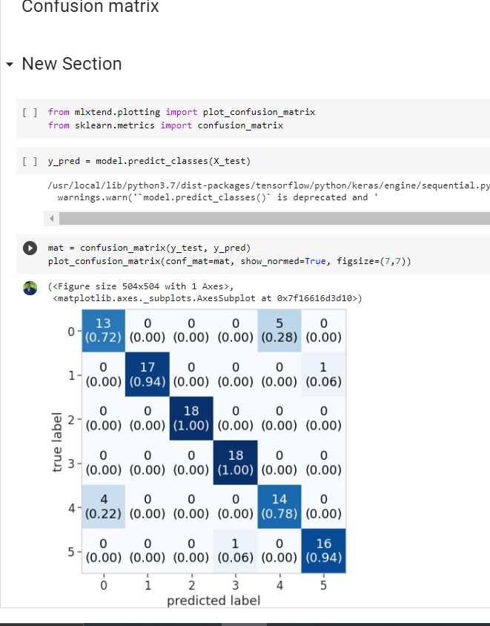
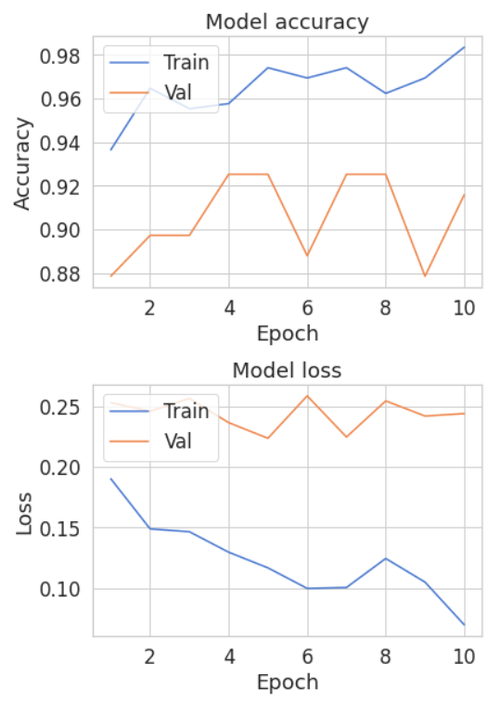
Confusion matrix &model accuracy/loss

Slide 17
Key Findings…..
In this paper, the significance of HAR research is analyzed, and an overview of emerging methods in the field is provided. LSTM neural networks have been used in many innovations in natural language processing, speech recognition, and weather prediction. This technology was adapted to the HAR task.
We proposed the novel framework of the Deep-Res-Bidir-LSTM network. This deep network can enhance learning ability for faster learning in early training.
In our experiments, the proposed network was able to improve the accuracy, by 4.78%, for the public domain UCI data set and increase the F1 score, by 3.68%, for the Opportunity data set in comparison with previous work.
We also found that window size was a key parameter. It will be important to find an adaptive way to automatically adjust the searching process and also make the neural network’s architecture evolve, such as automatically reshaping, adding, and removing various layers.
Also, exploring the effect of mixing 1D time-based convolutions at one or some points in the LSTM cells might improve results. Finally, applying the Deep-Res-Bidir-LSTM network to other fields could be revealing. A good model should have outstanding generalization.

Slide 18
BENEFITS:
Activity recognition is the basis for the development of many potential applications in health, wellness, or sports:
MONITOR HEALTH
Analyze the activity of a person from the information collected by different devices.
DISCOVER ACTIVITY PATTERNS
Discover which are the variables that determine which activity is doing a person.
DETECT ACTIVITY
Calculate a predictive model that can recognize a person's activity from the signals received by the sensors.
IMPROVE WELLBEING
Design individualized exercise tables to improve the health of a person.

Slide 19
Conclusion:
Here we conclude our project title as One can exploit the rich scope such insights has to offer in developing real time human asset monitoring in highly secured installations, tracking elderly or population with movement disability or illness for any emergencies based on movement patterns, determining if a person id under fatigue or not and so on and so forth. The application domains are as broad as from healthcare to security services and fitness monitoring. Human activity recognition framework provides mechanism to detect both normal and abnormal activities which includes body movements and actions of users using different multimodal data generated.

Slide 20
References…
[1] Pantelopoulos A, Bourbakis N G. A survey on wearable sensor-based systems for health monitoring and prognosis, IEEE Transactions on Systems Man & Cybernetics Part C Applications & Reviews. 40(1) (2015) 1–12.
[2] Ahmed S H, Kim D. Named data networking-based smart home, ICT Express. 2(3) (2016) 130–134.
[3] Rautaray S, Agrawal A. Vision based hand gesture recognition for human computer interaction: a survey, Artificial Intelligence Review. 43(1) (2017) 1–54.
[4] Chavarriaga R, Sagha H, Calatroni A, et al. The Opportunity challenge: A benchmark database for on-body sensor-based activity recognition, Pattern Recognition Letters. 34(15) (2016) 2033–2042.
[5] Dong C, Loy C, He K, et al. Learning a deep convolutional network for image super-resolution, in: European Conference on Computer Vision, 2018.
[6]Graves A, Mohamed A R, Hinton G. Speech recognition with deep recurrent neural networks, in: IEEE International Conference on Acoustics, Speech and Signal Processing. 2017.
[7]Abdel-Hamid O, Mohamed A R, Jiang H, et al. Convolutional Neural Networks for Speech Recognition, IEEE/ACM Transactions on Audio Speech & Language Processing. 22(22) (2014) 1533–1545.
[

Slide 21
Thanking you !!
Any Questions?
Name: Priyanshu Jain, Samyak Jain, Sarthak Ranka Email:jainpriyanshu77@gmail.com,jainsamyak445@gmail.com,sarthakranka23@gmail.com

